Slide 1
AUTO-CLASSIFICATION OF SURFACE WATER IN NORTHERN ARIZONA USING SENTINEL-2 IMAGERY
JOE SWEET
Dr. Rebecca Best
Dr. Daniel Buscombe
Northern Arizona University
School of Earth Sciences and Environmental Sustainability

Slide 2
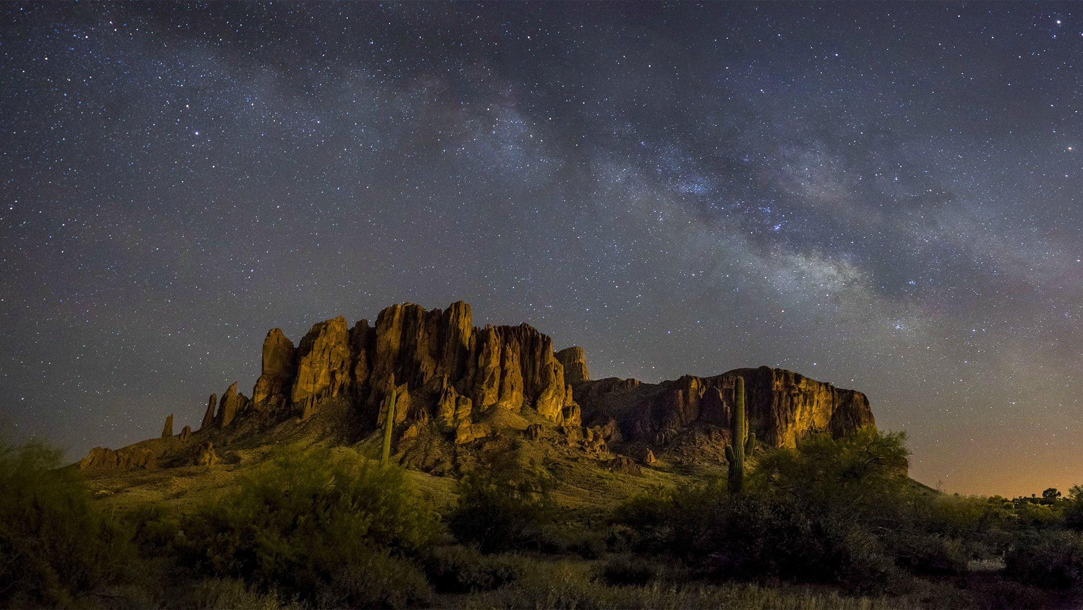
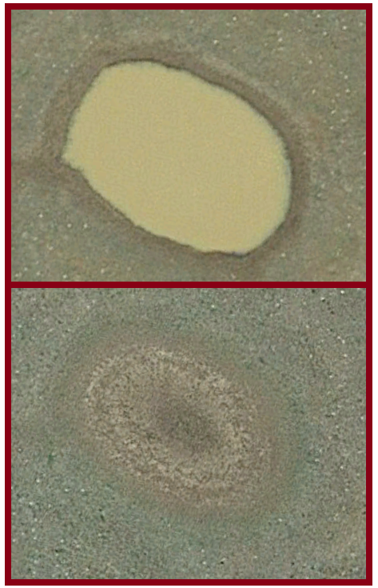
Semi-natural stock ponds of Northern Arizona
Occur at high densities
Connectivity and availability unknown in this arid landscape
Habitat components for native species
Introduction
April 2017
June 2017
Notes:
Arid landscape lacking aquatic habitat=important to understand where it is, a lot known about rivers
Many ponds ephemeral=availability
Image of wet and dry pond

Slide 3
Research Goals
Develop remote sensing method to detect the presence of surface water
Use results to test how pond permanence and connectivity depends on soil, geology, elevation and climate
Notes:
Connectivity for wildlife, get rid of third point

Slide 4
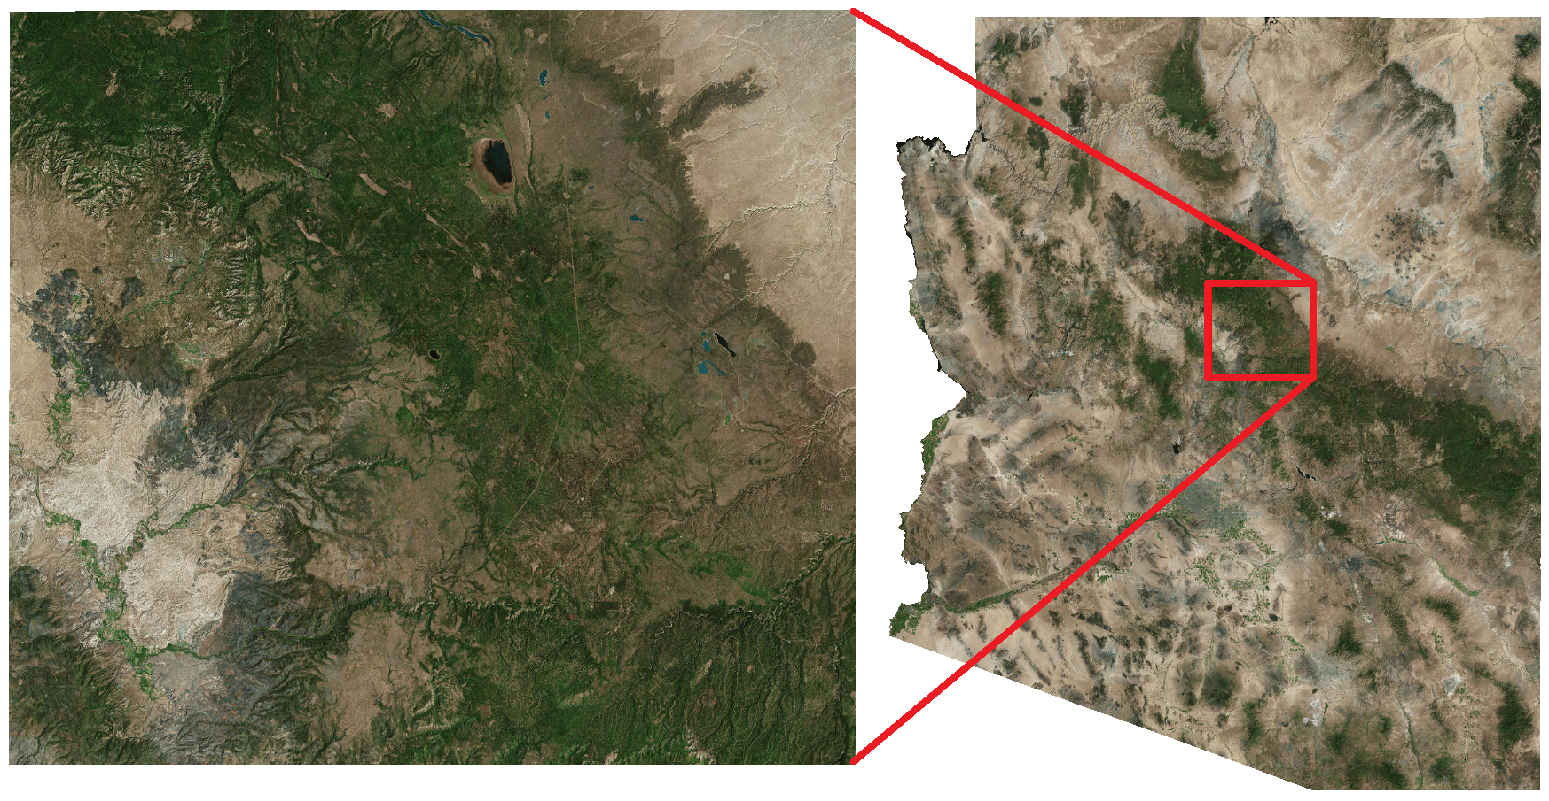
Area of Study
Lake Mary
Verde River
Mogollon Rim
Elevation gradient: 911–2582 meters
Notes:
Bullet points on elevation gradient

Slide 5
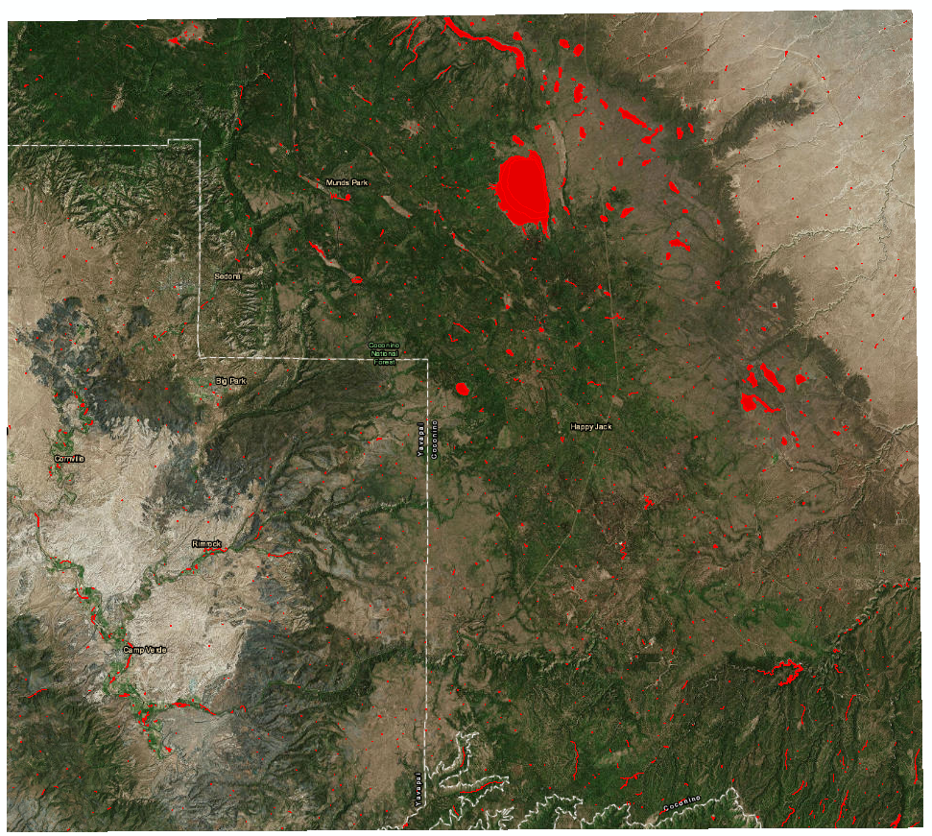
National Wetlands Inventory
Over 2000 water bodies
Comprehensive data set

Slide 6
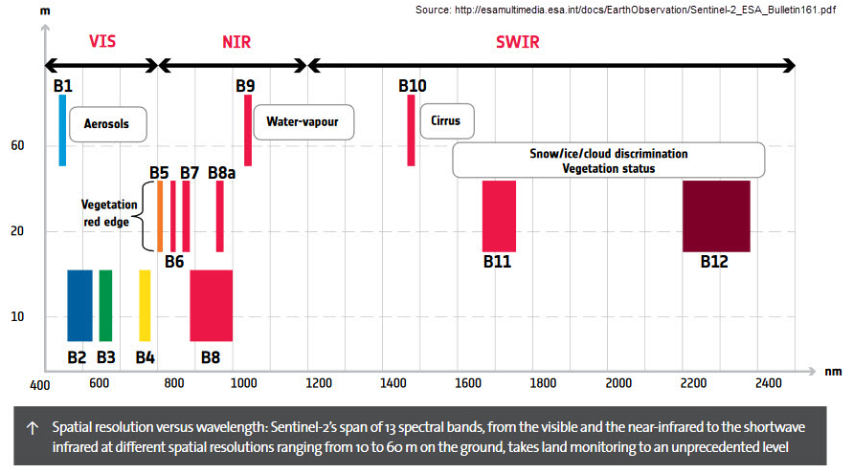
January 2016–today
Every 3 days to 3 weeks
13-Band Sentinel-2 Imagery
Notes:
Date of sentinel-2, 1-2 weeks new imagery, bands we’re using

Slide 7
Creating Classifiers
Semi-automatic Classification Plugin in QGIS
Preprocessing and Virtual Raster
Color composite

Slide 8
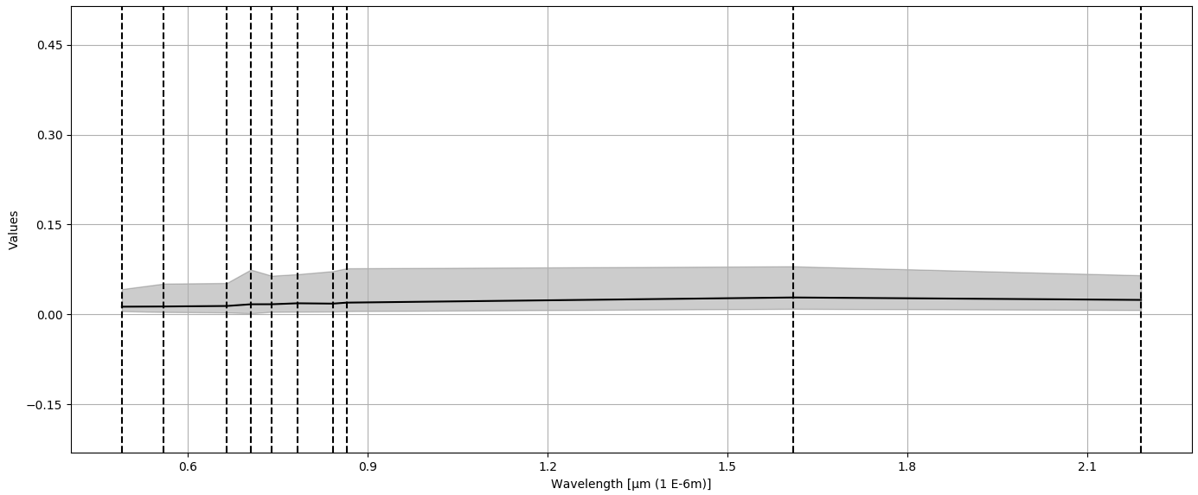
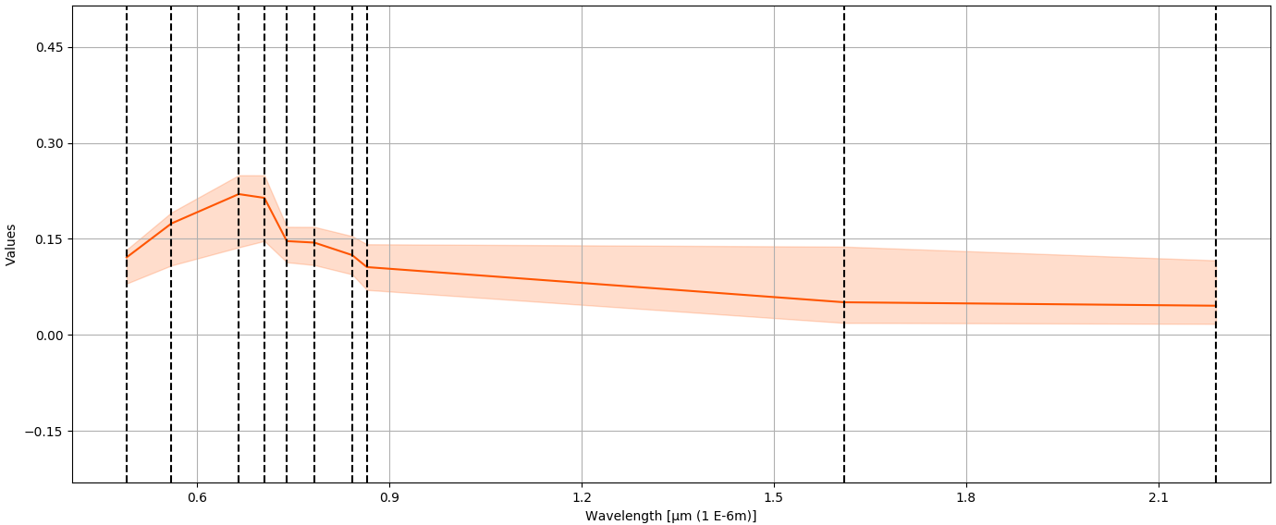
Spectral Signatures
Translucent water
Turbid water
Notes:
SPECTRAL RANGE
Axis need to be there, over 10 bands and corresponding muddy water
Muddy water has higher intensity

Slide 9
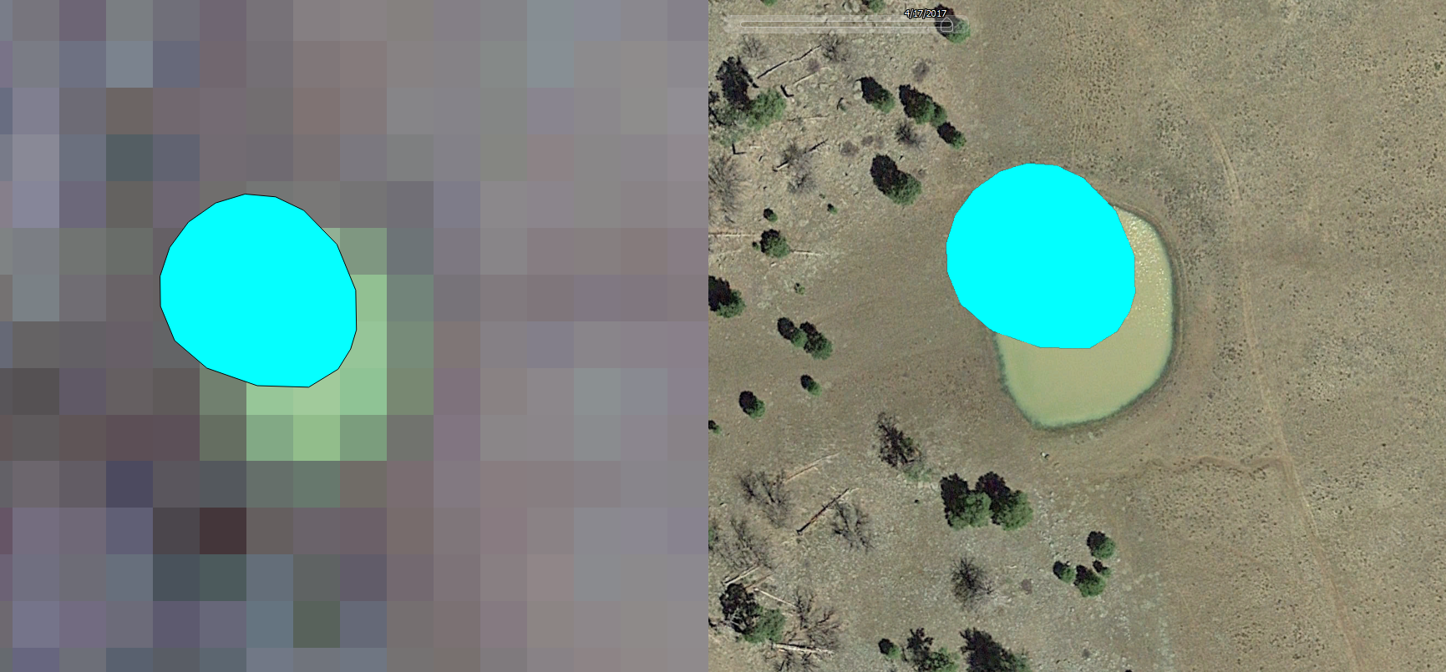
Temporally Associated Hyper-resolution Mosaics
Sentinel-2 April 15, 2017
Google Earth April 17, 2017
40 m
40 m
Notes:
Time period corresponds, only one, text with sentinel-2 google earth and date
Practice this slide, cm high resolution, scale bar

Slide 10
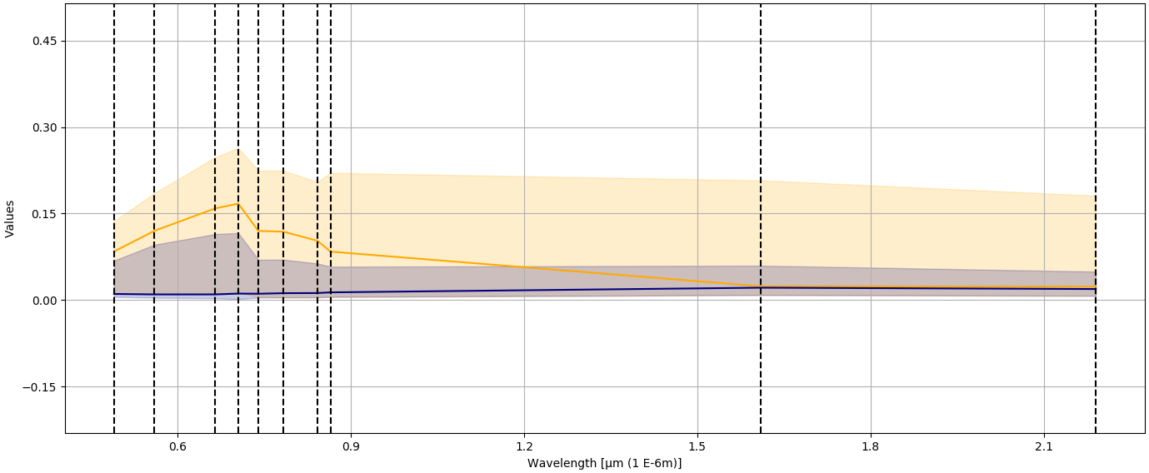
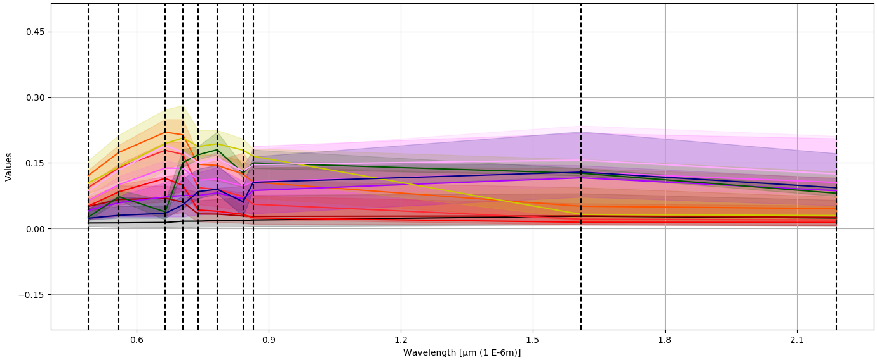
Classifier
Designs
Turbid
2 Signature Classifier
Clear
Turbid – Clear
11 Signature Classifier
Notes:
Two Class, 11 class, labels = turbid to clear

Slide 11
Testing Classifier Designs
Random sample of 50 wetlands polygons
Visually attributed
Overlaid with classification results
 | April | June | September | October
2 Signature | 0.93 | 0.62 | 0.80 | 0.76
11 Signature | 0.96 | 0.90 | 0.92 | 0.90
Notes:
change

Slide 12
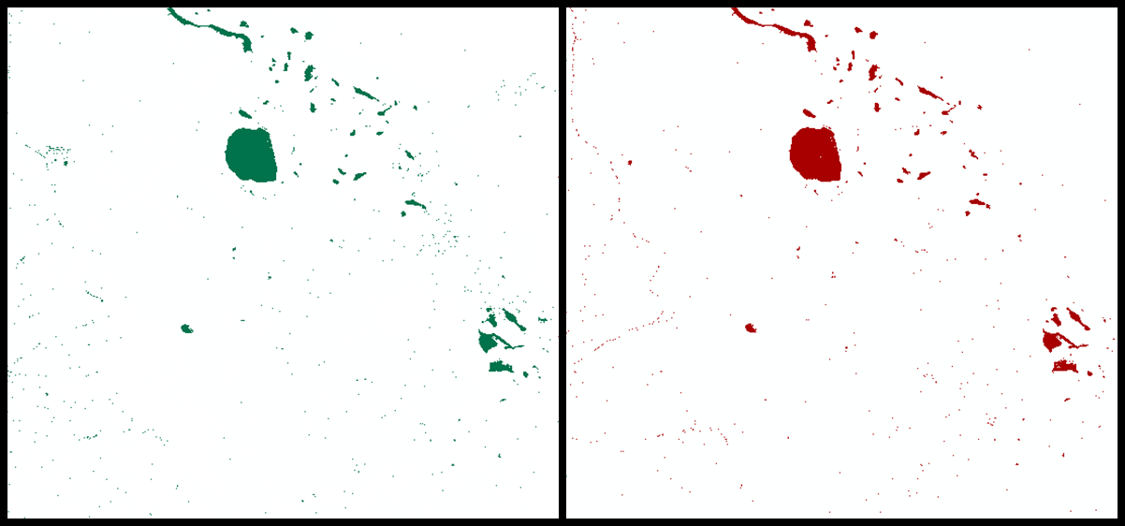
Results
High calibration accuracy
Acceptable out-of-calibration accuracy
Misclassification of certain out-of-calibration features
Lake Mary
Lake Mary
Mormon Lake
Mormon Lake
2 Signature Classifier
11 Signature Classifier
Notes:
Label features, make conclusion misclassification here

Slide 13
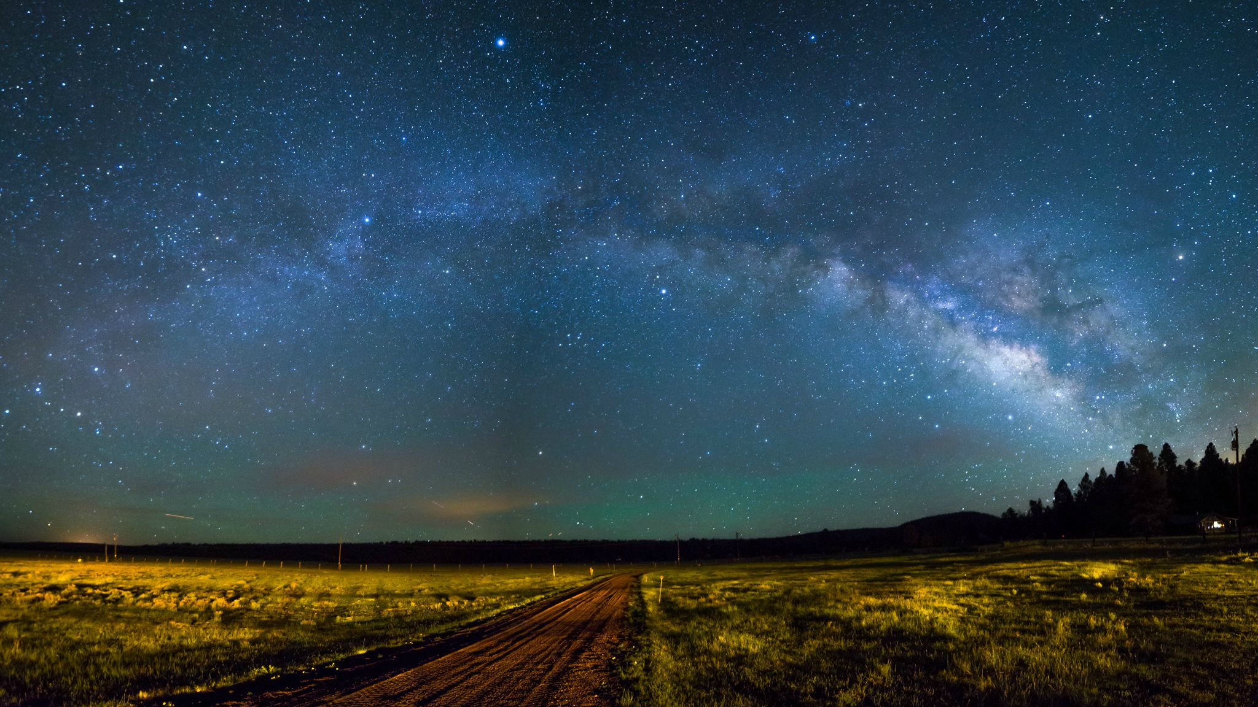
Continuing Work
Investigate methods to overcome inaccuracies
Infer habitat connectivity across environmental gradients
Notes:
Get rid of habitat quality, infer habitat connectivity across climate gradient
Title continuing work

Slide 14
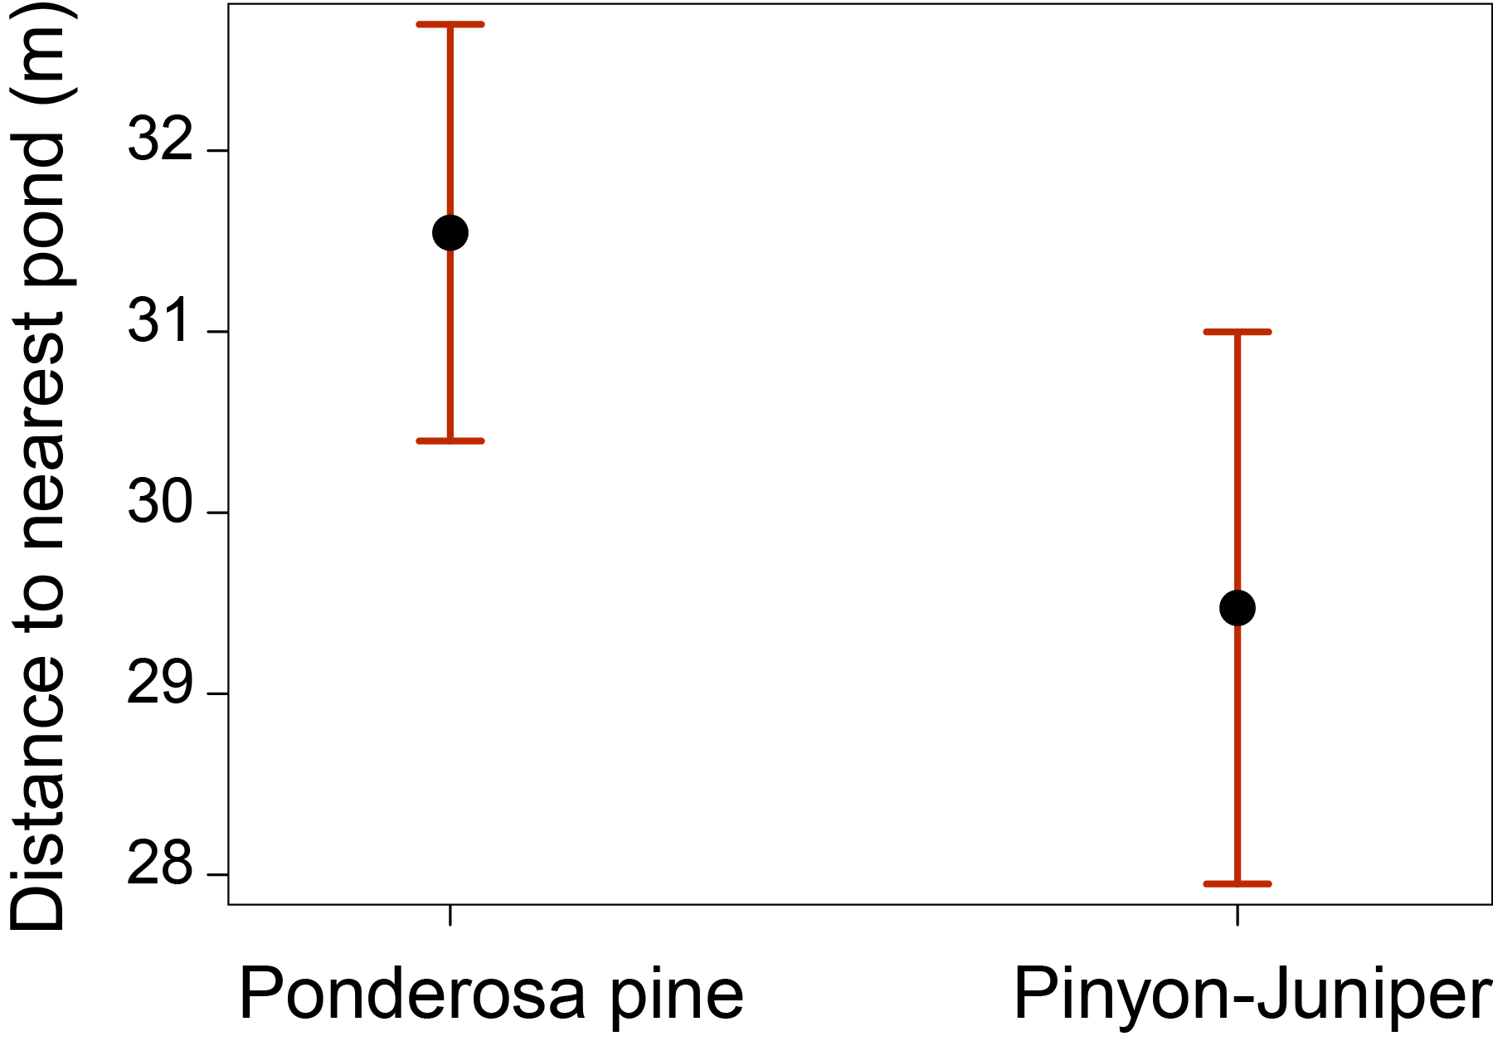
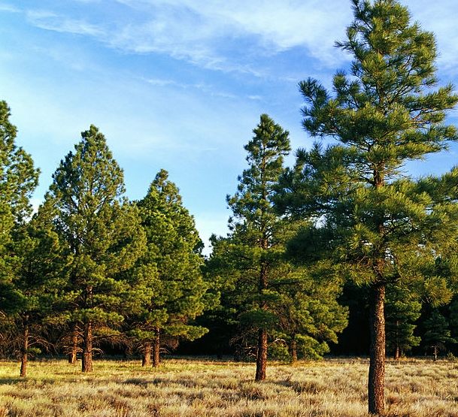
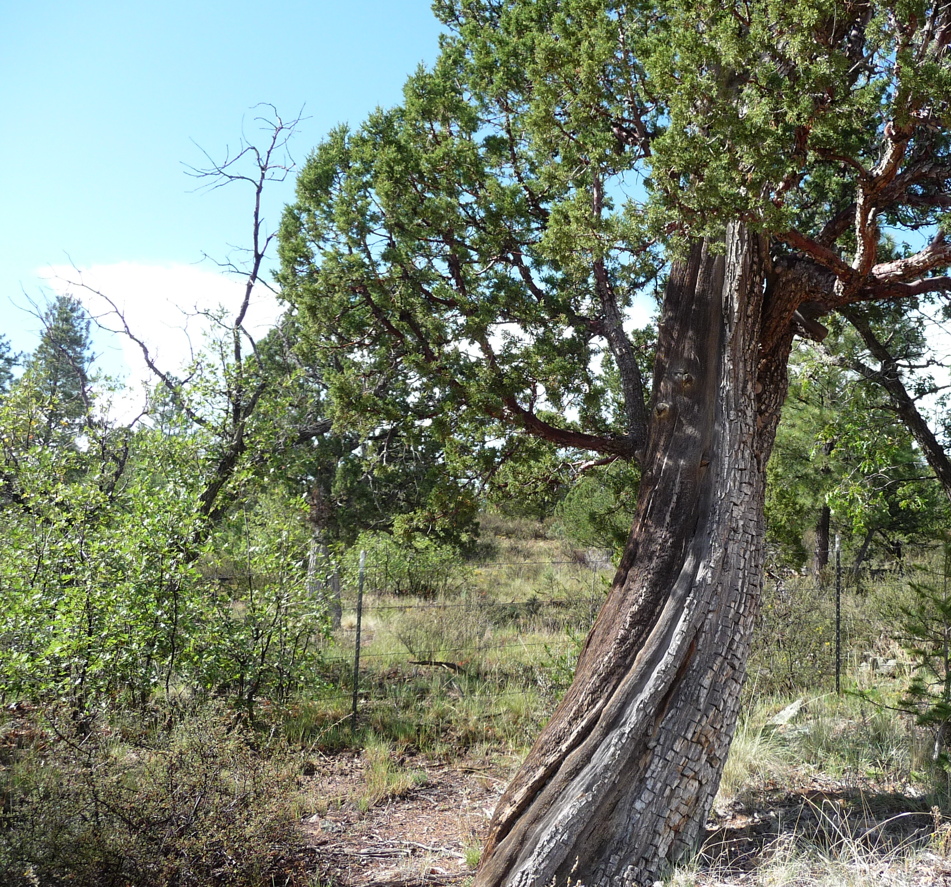
Connectivity of Nearest Pond in Ponderosa Pine and Pinyon-Juniper
p-value = 0.033

Slide 15
QUESTIONS

